Slide 1
Data Structures
and
Algorithms
CSCI 237 –
Fall 2019

Slide 2
Analysis of Algorithm Efficiency
Investigation of an algorithm’s efficiency with respect to two resources:
running time &
memory
The main tool of such an analysis is setting up a sum representing the algorithm’s running time (as a function of input size) and then simplifying the sum by using standard sum manipulation techniques.

Slide 3
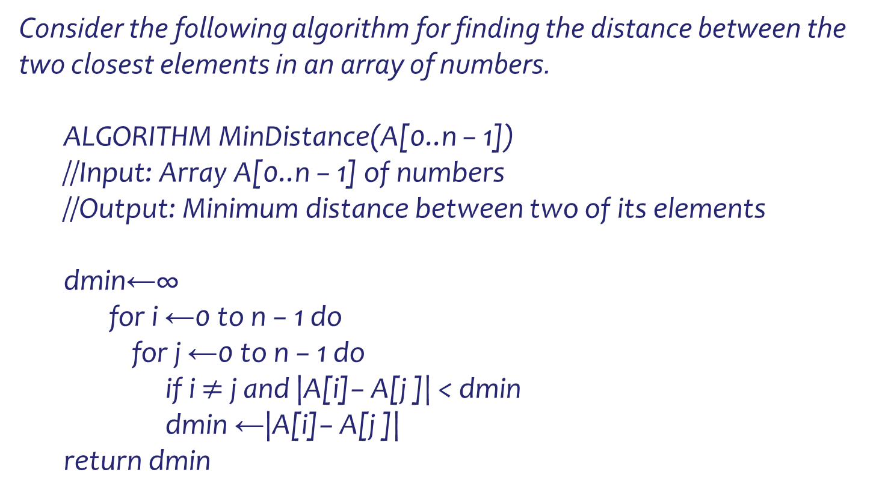
Analysis of Algorithm Efficiency
Consider the following algorithm for finding the distance between the two closest elements in an array of numbers.
ALGORITHM MinDistance(A[0..n − 1])
//Input: Array A[0..n − 1] of numbers
//Output: Minimum distance between two of its elements
dmin←∞
for i ←0 to n − 1 do
for j ←0 to n − 1 do
if i $≠$ j and |A[i]− A[j ]| < dmin
dmin ←|A[i]− A[j ]|
return dmin

Slide 4
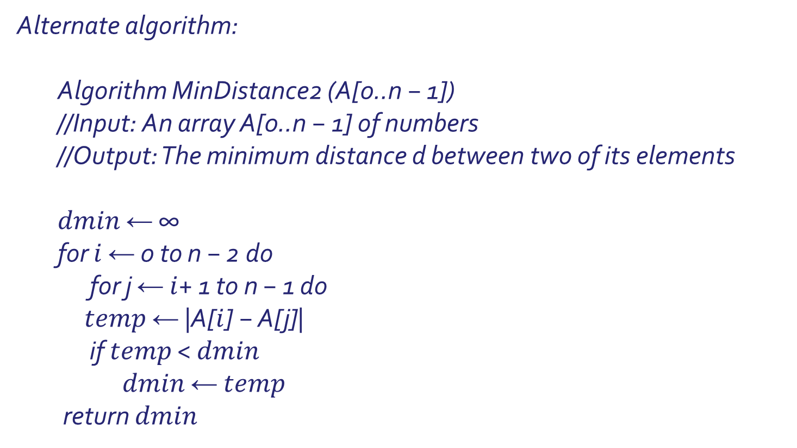
Analysis of Algorithm Efficiency
Alternate algorithm:
Algorithm MinDistance2 (A[0..n − 1])
//Input: An array A[0..n − 1] of numbers
//Output: The minimum distance d between two of its elements
$dmin$ ← ∞
for $i$ ← 0 to n − 2 do
for j ← $i$+ 1 to n − 1 do
$temp$ ← |A[$i$] − A[j]|
if $temp$ < $dmin$
$dmin$ ← $temp$
return $dmin$

Slide 5
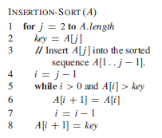
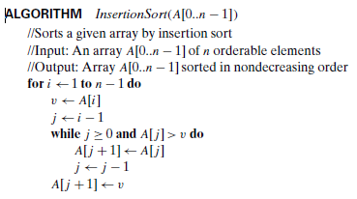
Analysis of Algorithm Efficiency
Another Example:

Slide 6
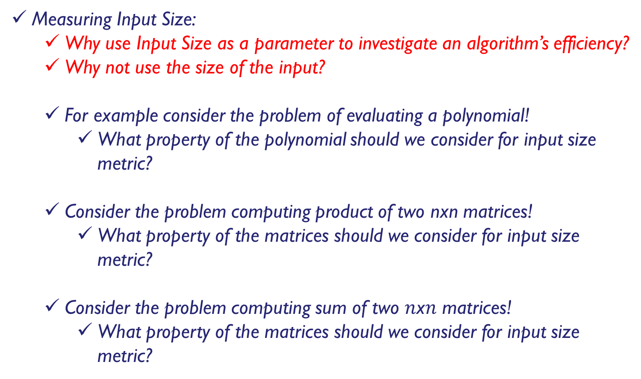
Analysis of Algorithm Efficiency
Measuring Input Size:
Why use Input Size as a parameter to investigate an algorithm’s efficiency?
Why not use the size of the input?
For example consider the problem of evaluating a polynomial!
What property of the polynomial should we consider for input size metric?
Consider the problem computing product of two nxn matrices!
What property of the matrices should we consider for input size metric?
Consider the problem computing sum of two $n$x$n$ matrices!
What property of the matrices should we consider for input size metric?

Slide 7
Analysis of Algorithm Efficiency
Some algorithms require more than one parameter to indicate the size of their inputs
Problems using graphs – need count of vertices and edges
How about computing the factorial value of positive integer?

Slide 8
Analysis of Algorithm Efficiency
How do we measure an input size for a spell checking algorithm?

Slide 9
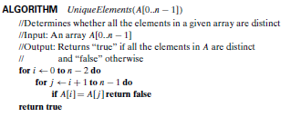
Perform the operations count
Consider the element uniqueness problem: check whether all the
elements in a given array of n elements are distinct. This problem can be solved by the following straightforward algorithm.

Slide 10
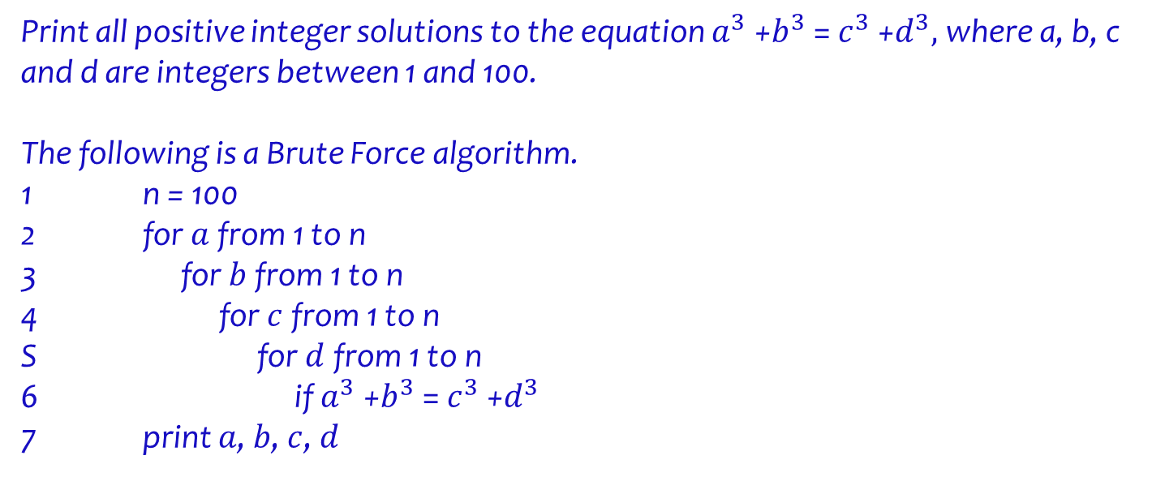
Perform the operations count
Print all positive integer solutions to the equation $a^{3}$ +$b^{3}$ = $c^{3}$ +$d^{3},$where a, b, c and d are integers between 1 and 100.
The following is a Brute Force algorithm.
1 n = 100
2 for $a$ from 1 to n
3 for $b$ from 1 to n
4 for $c$ from 1 to n
S for $d$ from 1 to n
6 if $a^{3}$ +$b^{3}$ = $c^{3}$ +$d^{3}$
7 print $a$, $b$, $c$, $d$

Slide 11
Analysis of Algorithm Efficiency
Units for measuring running time:
Can we use the run time as a measure? Why or Why not?
Depends on speed of particular computer
Depends on quality of programming
Depends on compiler used to generate machine code
Difficulty of clocking the actual running time of the program
One possible approach is to count the number of times each of the algorithm’s operations is executed.
This approach is both excessively difficult and, as we shall see, usually unnecessary.
The thing to do is to identify the most important operation of the algorithm - basic operation,
the operation contributing the most to the total running time, &
compute the number of times the basic operation is executed

Slide 12
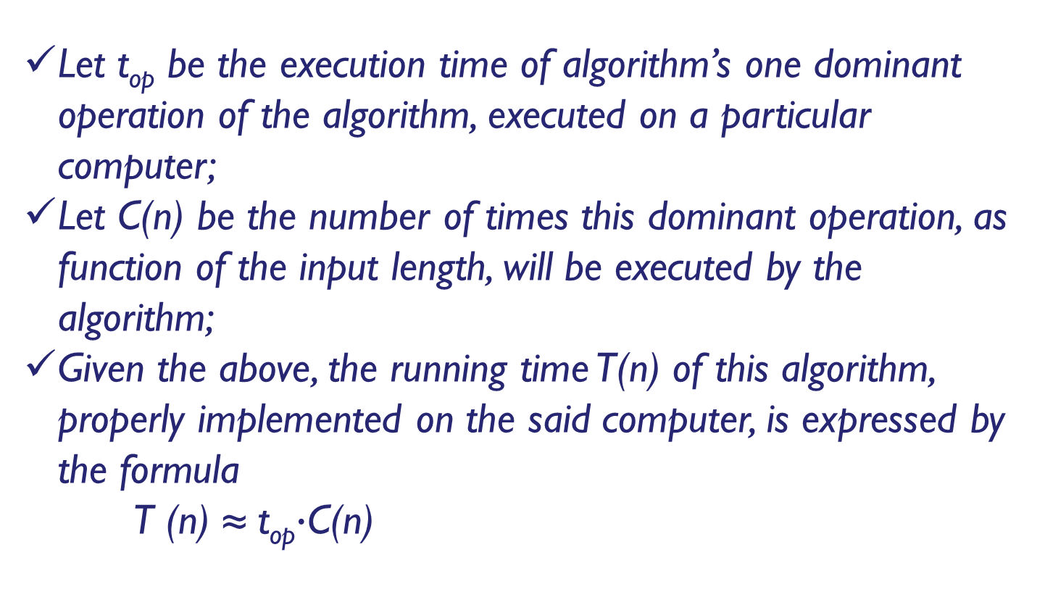
Analysis of Algorithm Efficiency
Let t_{op} be the execution time of algorithm’s one dominant operation of the algorithm, executed on a particular computer;
Let C(n) be the number of times this dominant operation, as function of the input length, will be executed by the algorithm;
Given the above, the running time T(n) of this algorithm, properly implemented on the said computer, is expressed by the formula
T (n) ≈ t_{op}$∙$C(n)

Slide 13
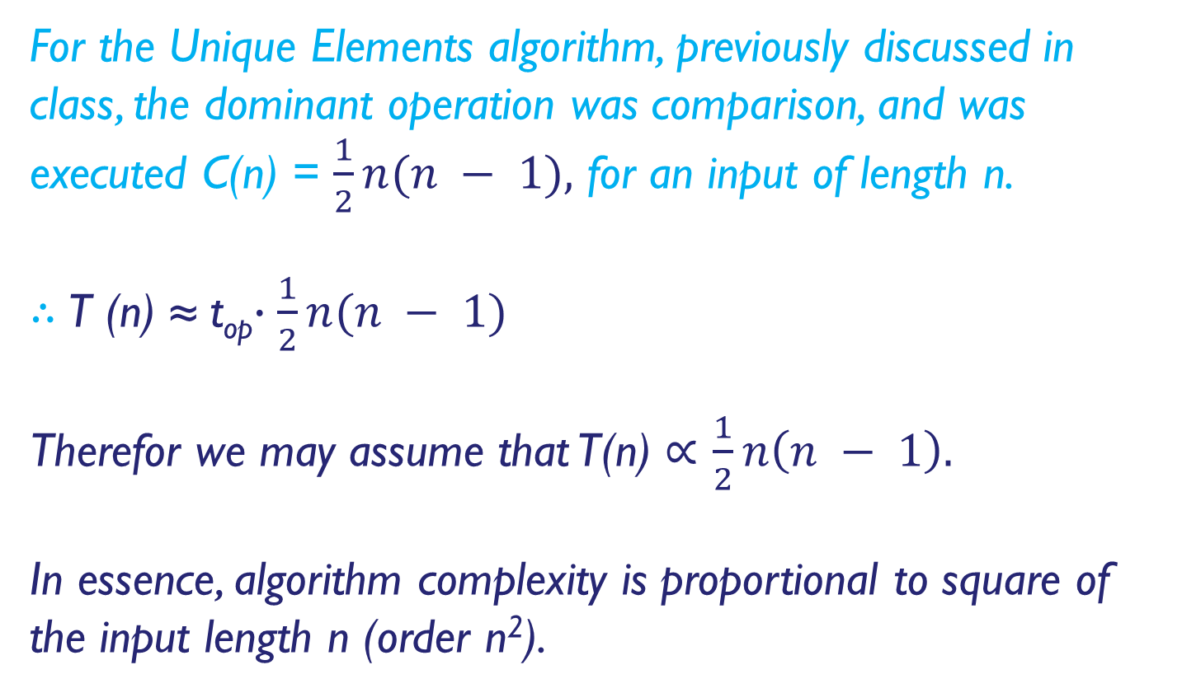
Analysis of Algorithm Efficiency
For the Unique Elements algorithm, previously discussed in class, the dominant operation was comparison, and was executed C(n) = $\frac{1}{2}n(n − 1),$ for an input of length n.
$∴$T (n) ≈ t_{op}$∙\frac{1}{2}n(n − 1)$
Therefor we may assume that T(n) $∝$ $\frac{1}{2}n\left(n − 1\right).$
In essence, algorithm complexity is proportional to square of the input length n (order n²).

Slide 14
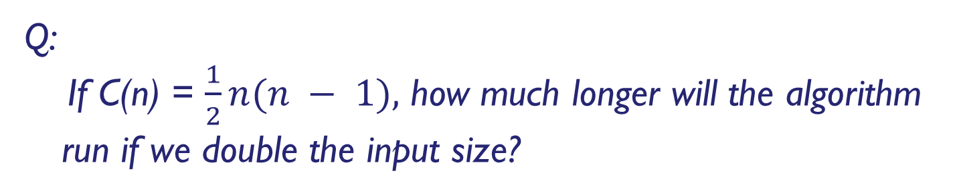
Analysis of Algorithm Efficiency
Q:
If C(n) = $\frac{1}{2}n(n − 1),$ how much longer will the algorithm run if we double the input size?

Slide 15


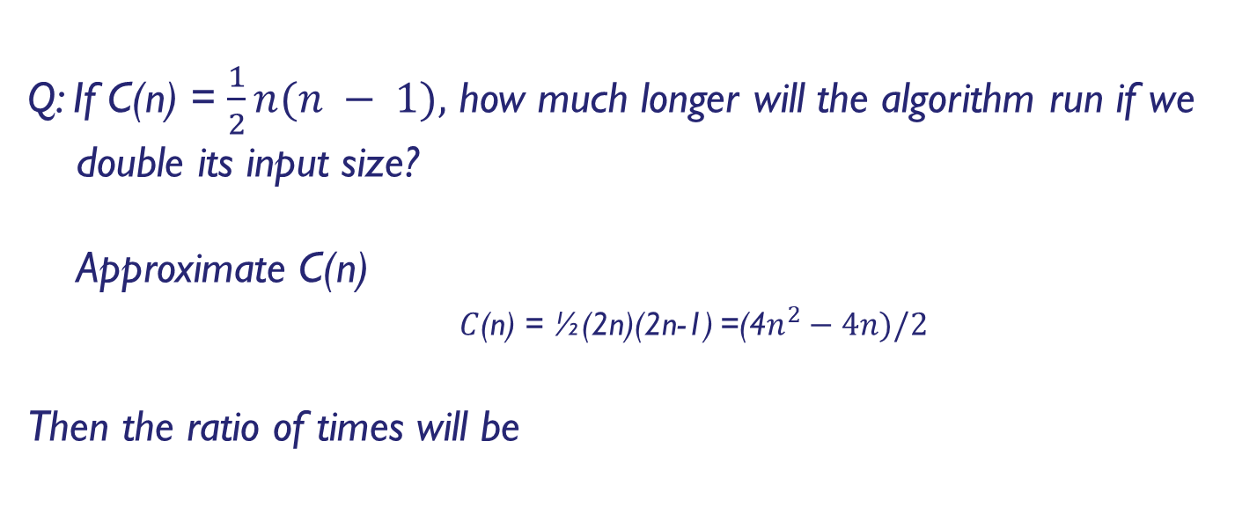
Analysis of Algorithm Efficiency
Q: If C(n) = $\frac{1}{2}n(n − 1),$ how much longer will the algorithm run if we double its input size?
Approximate C(n)
$C$(n) = ½(2n)(2n-1) =(4$n^{2}−4n)/2$
Then the ratio of times will be

Slide 16
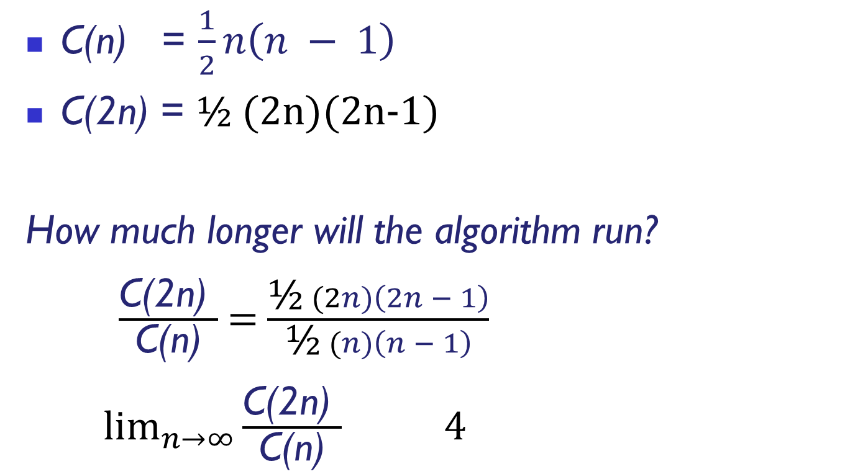
C(n) = $\frac{1}{2}n\left(n − 1\right)$
C(2n) = ½ (2n)(2n-1)
How much longer will the algorithm run?
$\frac{\text{C}\text{(2}\text{n}\text{) }}{\text{C}\text{(}\text{n}\text{)}}$ = $\frac{\text{½} (2n)\left(2n − 1\right)}{\text{½} (n)\left(n − 1\right)}$
$\lim_{n→∞}{\frac{\text{C}\text{(2}\text{n}\text{) }}{\text{C}\text{(}\text{n}\text{)}}}$ 4

Slide 17
Order of Growth

Slide 18
Selecting a metric, identifying the basic operation
For each of the following algorithms, indicate
(i) a natural input size (metric for its inputs),
(ii) the dominant basic operation, and
(iii) whether the basic operation count can be different for inputs of the same size:
a. computing the sum of n numbers
b. computing n!
c. finding the largest element in a list of n numbers
d. pen-and-pencil algorithm for multiplying two n-digit decimal integers

Slide 19
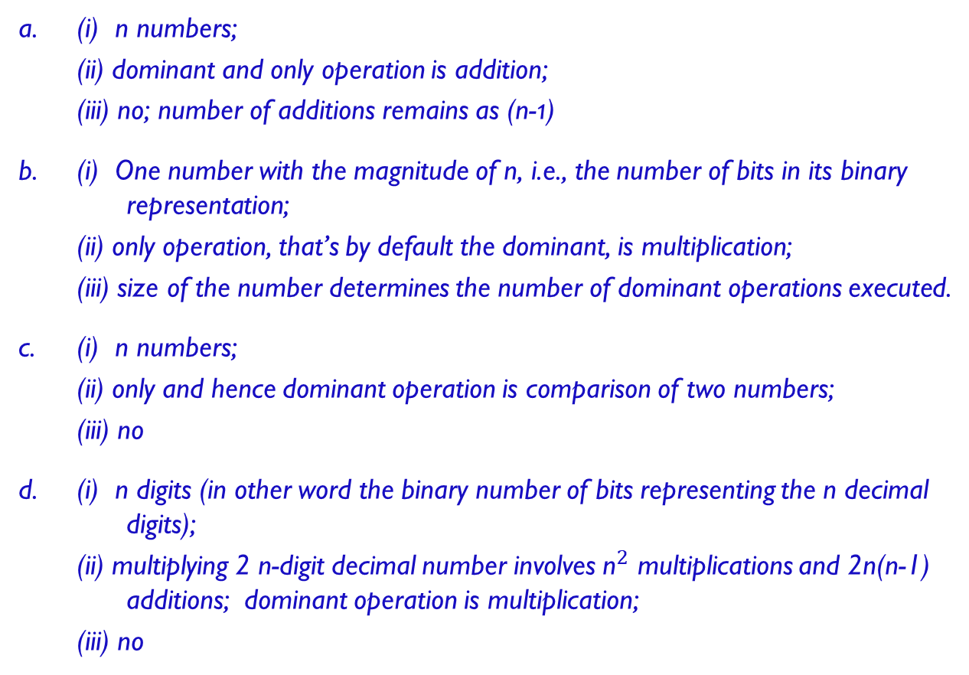
Answers
a. (i) n numbers;
(ii) dominant and only operation is addition;
(iii) no; number of additions remains as (n-1)
b. (i) One number with the magnitude of n, i.e., the number of bits in its binary representation;
(ii) only operation, that’s by default the dominant, is multiplication;
(iii) size of the number determines the number of dominant operations executed.
c. (i) n numbers;
(ii) only and hence dominant operation is comparison of two numbers;
(iii) no
d. (i) n digits (in other word the binary number of bits representing the n decimal digits);
(ii) multiplying 2 n-digit decimal number involves ${\text{n}}^{2}$ multiplications and 2n(n-1) additions; dominant operation is multiplication;
(iii) no

Slide 20
Worst-Case, Best-Case, and Average-Case Efficiencies
For some algorithms run-time will depend not only on the input size but also on the specifics of a particular input.
For example: Searching for a given key K in a list of n elements.
Worst-Case efficiency:
For an input of size n the algorithm runs the longest among all the inputs of a given input size.
In other words, for an input of size n, the basic operations count c_{op} is the largest value among all possible inputs of size n.
Example: For sequential search what is the C_{worst}(n)?

Slide 21
Worst-Case, Best-Case, and Average-Case Efficiencies
Best-Case efficiency:
For an input of size n the algorithm runs the fastest among all the inputs of that size.
In other words, for an input of size n, the basic operations count c_{op} is the smallest value among all possible inputs of size n.

Slide 22
Worst-Case, Best-Case, and Average-Case Efficiencies
Find the Best and Worse case for the following examples :
finding the largest element in a list of n numbers
find key K within the given ordered list of n numbers

Slide 23
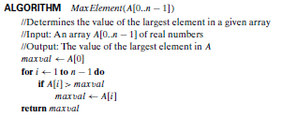
Worst-Case, Best-Case, and Average-Case Efficiencies
Worst-Case, Best-Case, and Average-Case Efficiencies
Ex 1: Consider the problem of finding the value of the largest element
in a list of n numbers. For simplicity, we assume that the list is implemented as
an array.
The following is pseudocode of a standard algorithm for solving the
problem.

Slide 24
Worst-Case, Best-Case, and Average-Case Efficiencies
Average-Case efficiency:
Neither best-case nor worst-case gives impression about algorithm’s behavior on typical or random input.
So what can this measurement provide as information about the algorithm?
Typically this is the operational count, for random input of n.
MAKE NO MISTAKE : AVERAGE *is not (always) equal to* (BEST + WORST)/2

Slide 25
Worst-Case, Best-Case, and Average-Case Efficiencies
Average-Case efficiency:
Example: For sequential search what is the C_{avg} (n)?
Pseudocode for an algorithm to search an array
Algorithm to search a[first] through a[last] for desiredItem if (there are no elements to search) return false else if (desiredItem equals a[first]) return true else return the result of searching a[first+1] through a[last]

Slide 26
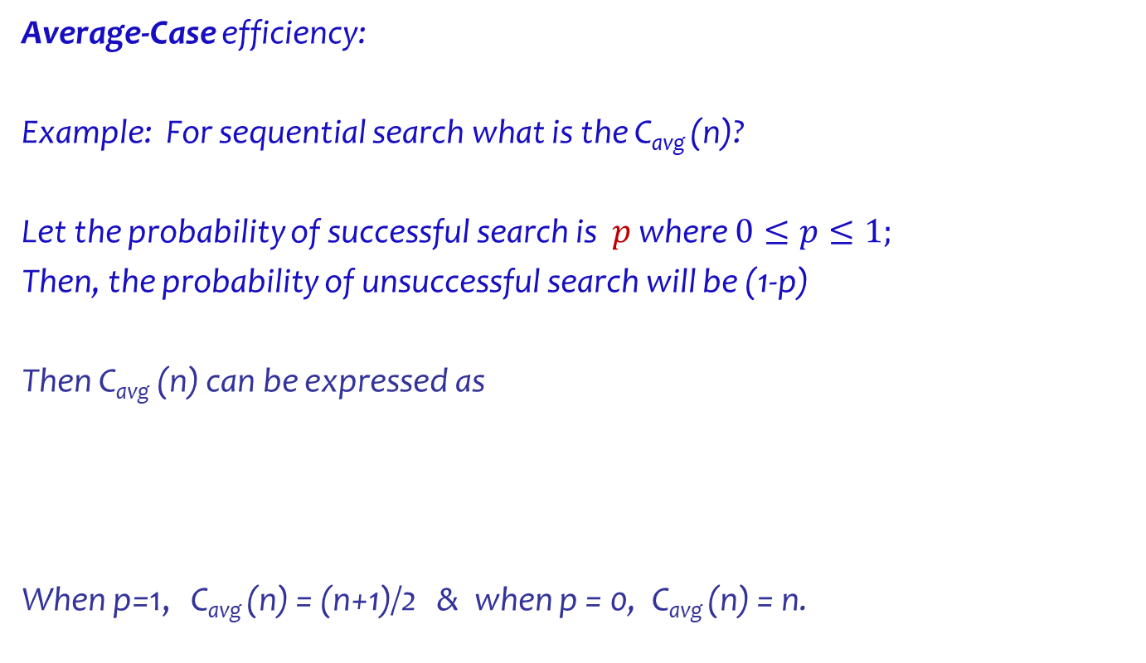
Worst-Case, Best-Case, and Average-Case Efficiencies
Average-Case efficiency:
Example: For sequential search what is the C_{avg} (n)?
Let the probability of successful search is $p$ where $0≤p≤1;$
Then, the probability of unsuccessful search will be (1-p)
Then C_{avg} (n) can be expressed as
When p=1, C_{avg} (n) = (n+1)/2 & when p = 0, C_{avg} (n) = n.

Slide 27

Examples

Slide 28
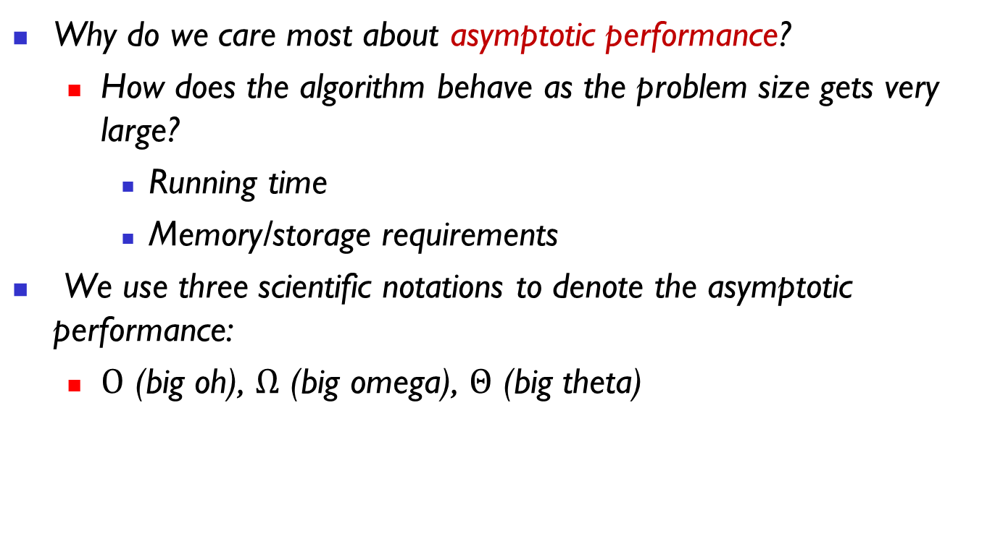
Asymptotic Notations and Basic Efficiency Classes
Why do we care most about asymptotic performance?
How does the algorithm behave as the problem size gets very large?
Running time
Memory/storage requirements
We use three scientific notations to denote the asymptotic performance:
$Ο$ (big oh), $Ω$ (big omega), $Θ$ (big theta)

Slide 29
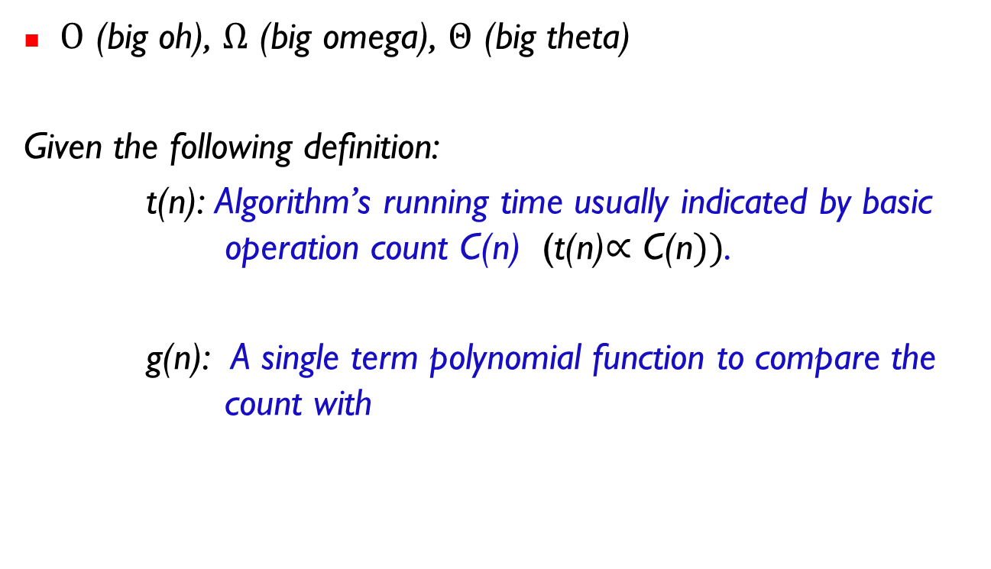
Asymptotic Notations and Basic Efficiency Classes
$Ο$ (big oh), $Ω$ (big omega), $Θ$ (big theta)
Given the following definition:
t(n): Algorithm’s running time usually indicated by basic operation count C(n) (t(n)$∝\text{C}\text{(}\text{n}))$.
g(n): A single term polynomial function to compare the count with

Slide 30
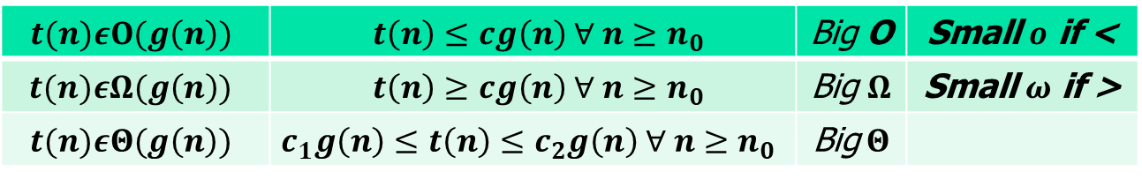


Asymptotic Notations and Basic Efficiency Classes
$Ο$ (big oh), $Ω$ (big omega), $Θ$ (big theta)
$$t(n)εΟ(g\left(n\right))$$ | $t\left(n\right)≤cg\left(n\right) ∀ n≥n_{0}$ | Big O | Small $ο$ if <
$$t(n)εΩ(g\left(n\right))$$ | $t\left(n\right)≥cg\left(n\right) ∀ n≥n_{0}$ | Big $Ω$ | Small $ω$ if >
$$t(n)εΘ(g\left(n\right))$$ | $$c_{1}g\left(n\right)≤t\left(n\right)≤c_{2}g\left(n\right) ∀ n≥n_{0}$$ | Big$Θ$
Specifically,
$Ο(g\left(n\right)$) is the set of all functions with a higher or same order of growth order as $g\left(n\right)$, to within a constant multiple, as n $→∞.$
$Ω(g\left(n\right)$) is the set of all functions with a lower or same order of growth order as $g\left(n\right)$, to within a constant multiple, as n $→∞.$
$Θ(g\left(n\right)$) is the set of all functions with a same order of growth order as $g\left(n\right)$, to within a constant multiple, as n $→∞.$
A function $t\left(n\right)$is said to be in $Ω(g\left(n\right)$), denoted by $t\left(n\right) ε$C $∙ g\left(n\right)$, for all n$≥n0$.
$t\left(n\right)$ is bounded below by $C∙g\left(n\right)$.

Slide 31
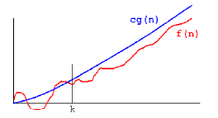


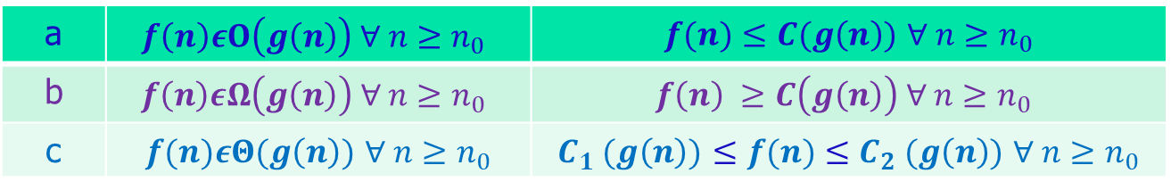
$Ο$ Example
$$n_{0}$$
a | $$f\left(n\right)εΟ\left(g\left(n\right)\right) ∀ n≥n_{0}$$ | $f(n)≤C(g\left(n\right))$ $∀ n≥n_{0}$
b | $$f\left(n\right)εΩ\left(g\left(n\right)\right) ∀ n≥n_{0}$$ | $$f\left(n\right) ≥C\left(g\left(n\right)\right) ∀ n≥n_{0}$$
c | $f(n)εΘ(g\left(n\right))$ $∀ n≥n_{0}$ | $C_{1} (g\left(n\right))$ $≤f(n)≤C_{2} (g\left(n\right))$ $∀ n≥n_{0}$

Slide 32
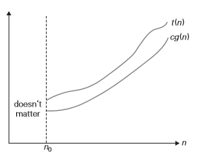


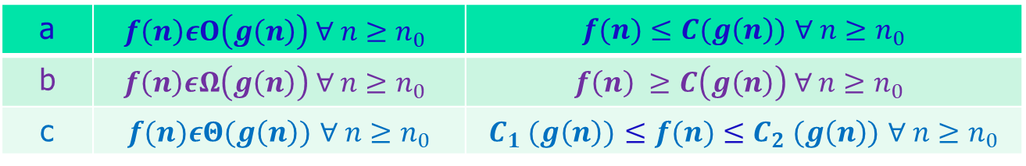

$Ω$ Example
$$f(n)$$
a | $$f\left(n\right)εΟ\left(g\left(n\right)\right) ∀ n≥n_{0}$$ | $f(n)≤C(g\left(n\right))$ $∀ n≥n_{0}$
b | $$f\left(n\right)εΩ\left(g\left(n\right)\right) ∀ n≥n_{0}$$ | $$f\left(n\right) ≥C\left(g\left(n\right)\right) ∀ n≥n_{0}$$
c | $f(n)εΘ(g\left(n\right))$ $∀ n≥n_{0}$ | $C_{1} (g\left(n\right))$ $≤f(n)≤C_{2} (g\left(n\right))$ $∀ n≥n_{0}$

Slide 33
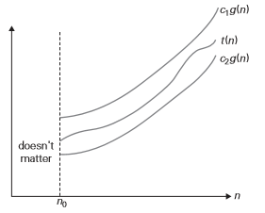



$Θ$ Example
$$f(n)$$
a | $$f\left(n\right)εΟ\left(g\left(n\right)\right) ∀ n≥n_{0}$$ | $f(n)≤C(g\left(n\right))$ $∀ n≥n_{0}$
b | $$f\left(n\right)εΩ\left(g\left(n\right)\right) ∀ n≥n_{0}$$ | $$f\left(n\right) ≥C\left(g\left(n\right)\right) ∀ n≥n_{0}$$
c | $f(n)εΘ(g\left(n\right))$ $∀ n≥n_{0}$ | $C_{1} (g\left(n\right))$ $≤f(n)≤C_{2} (g\left(n\right))$ $∀ n≥n_{0}$

Slide 34
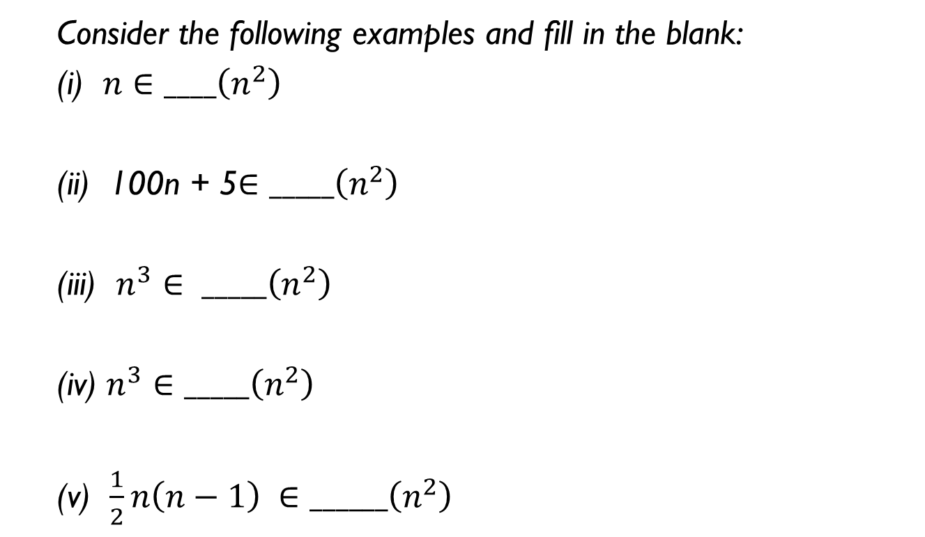
Asymptotic Notations and Basic Efficiency Classes
Consider the following examples and fill in the blank:
(i) $n∈____\left(n^{2}\right)$
(ii) 100n + 5$∈_____\left(n^{2}\right)$
(iii) $n^{3}$ $∈ _____\left(n^{2}\right)$
(iv) $n^{3}$ $∈_____\left(n^{2}\right)$
(v) $\frac{1}{2}n\left(n−1\right) ∈______\left(n^{2}\right)$

Slide 35
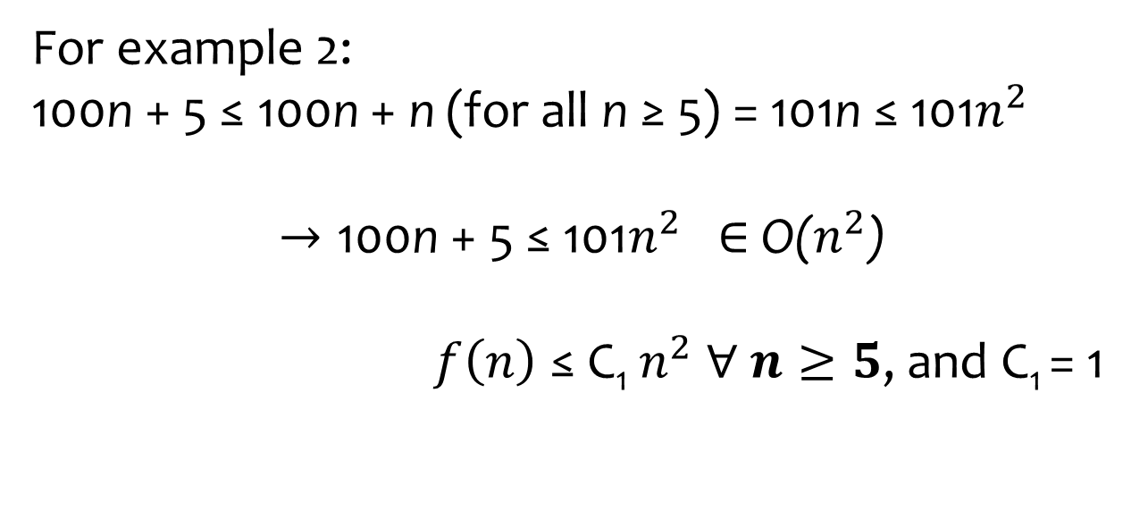
Example 5
For example 2:
100n + 5 ≤ 100n + n (for all n ≥ 5) = 101n ≤ 101$n^{2}$
$$→\text{100}\text{n} \text{+ 5} \text{≤ 101}n^{2} \text{∈ }\text{O}\text{(}n^{2}\text{)}$$
$f\left(n\right) \text{≤}$ C₁ $n^{2} ∀ n≥5$, and C₁ = 1

Slide 36


Example 5
Try the rest for yourself:
100n + 5 ≤ 100n + 5n (for all n ≥ 1) = 105n $→$ $\text{100}\text{n} \text{+ 5 ∈ }\text{__}\text{(}\text{n}\text{)}$
$n^{3}$ ≥ $n^{2}$ for all $n$ ≥ 0, $→$ $n^{3}$ ∈ $Ω$($n^{2}$)
$\frac{1}{2}n(n − 1)$ ∈ $Ω$($n^{2}$)
$n^{4}$ + $n$ + 1 ∈ $Ω$($n^{2}$)
$\frac{1}{2}n(n − 1)$ ∈ $Θ$($n^{2}$)
Why?

Slide 37

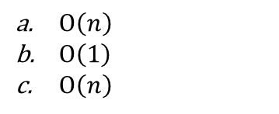
Asymptotic Notations and Basic Efficiency Classes
$Ο\left(n\right)$
$Ο\left(1\right)$
$Ο\left(n\right)$
ALGORITHM SequentialSearch(A[0..n − 1], K)
//Searches for a given value in a given array by sequential search
//Input: An array A[0..n − 1] and a search key K
//Output: The index of the first element in A that matches K
// or −1 if there are no matching elements
i ←0
while i < n and A[i] = K do
i ←i + 1
if i < n return i
else return −1

Slide 38
Grouping time functions
Functions that grow roughly at the same rate are in the same Big-O category
Constant time: O(1)
Logarithmic time: O(log₂n) = O(lg n)
Linear time: O(n)
Quadratic time: O(n²)
Exponential time: O(2^{n})
We abstract and simplify to obtain hardware independent results:
O(n² + 5n) = O(n²), O(n + log n) = O(n)

Slide 39
Dominance relations on functions
Our goal is to obtain a hierarchy of sets of time functions to classify algorithm runtimes
O(n) functions dominate O(lg n),
O(n²) dominates O(n), etc.
Non-dominant terms in time functions are discarded
Constant terms and factors are discarded
Example: O(3n² + 2n – 100) simplifies to O(n²)

Slide 40
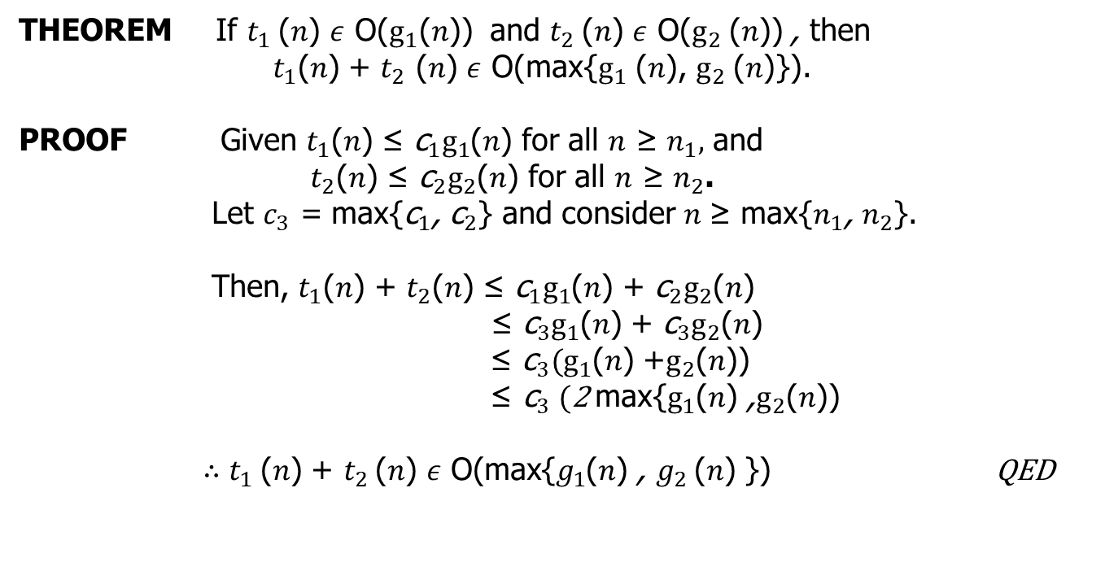
Useful Property Involving the Asymptotic Notations
THEOREM If $t_{1}$($n$) $ε$ O($g_{1}$($n$)) and $t_{2}$($n$) $ε$ O($g_{2}$($n$)) , then
$t_{1}$($n$) + $t_{2}$ ($n$) $ε$ O(max{$g_{1}$ ($n$), $g_{2}$($n$)}).
PROOF Given $t_{1}$($n$) ≤ ${\text{c}}_{1}g_{1}$($n$) for all $n$ ≥ $n_{1},$ and
$t_{2}$($n$) ≤ ${\text{c}}_{2}g_{2}$($n$) for all $n$ ≥ $n_{2}$.
Let $c_{3}$ = max{${\text{c}}_{1}$, ${\text{c}}_{2}$} and consider $n$≥ max{$n_{1}$, $n_{2}$}.
Then, $t_{1}$($n$) + $t_{2}$($n$) ≤ ${\text{c}}_{1}g_{1}$($n$) + ${\text{c}}_{2}g_{2}$($n$)
≤ ${\text{c}}_{3}g_{1}$($n$) + ${\text{c}}_{3}g_{2}$($n$)
≤ ${\text{c}}_{3}(g_{1}$($n$) +$g_{2}$($n$))
${\text{≤} \text{c}}_{3}(\text{2 }\text{max}\text{\{}g_{1}$($n$) $\text{,}g_{2}$($n$))
$∴t_{1}$($n$) $\text{+ }t_{2}$($n$) $ε \text{O}\text{(}\text{max}\text{\{}g_{1}$($n$) $\text{, }g_{2}$($n$) $\text{\})}$ QED
Latin phrase quod erat demonstrandum, meaning "which is what had to be proved".

Slide 41

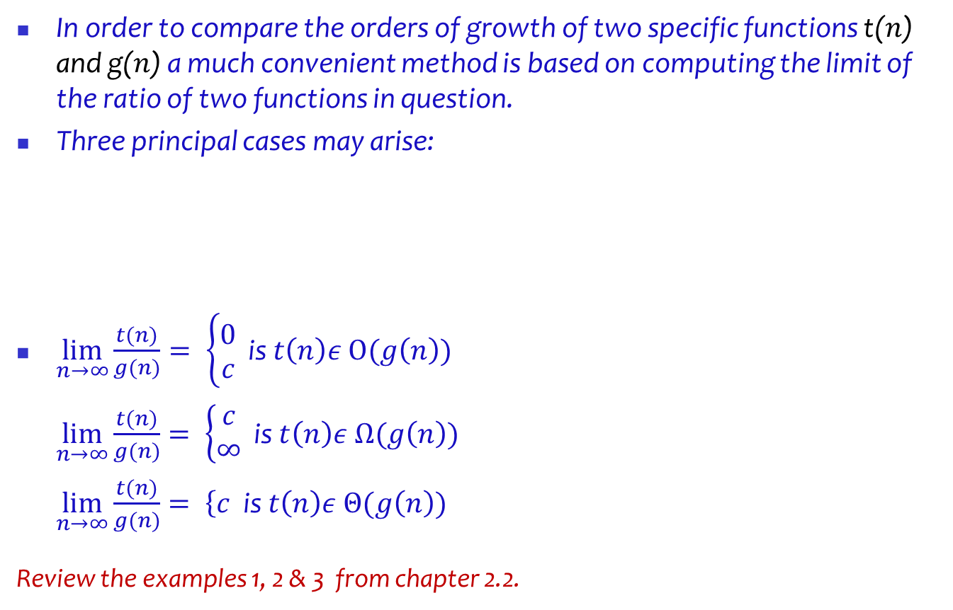
Asymptotic Notations and Basic Efficiency Classes
In order to compare the orders of growth of two specific functions t($n$) and g($n$) a much convenient method is based on computing the limit of the ratio of two functions in question.
Three principal cases may arise:
$\lim_{n→∞}{\frac{t(n)}{g(n)}}= \left\{\begin{aligned}0 \\ c\end{aligned}\right.$ is $t\left(n\right)ε Ο(g\left(n\right))$
$\lim_{n→∞}{\frac{t(n)}{g(n)}}= \left\{\begin{aligned}c \\ ∞\end{aligned}\right.$ is $t\left(n\right)ε Ω(g\left(n\right))$
$\lim_{n→∞}{\frac{t(n)}{g(n)}}= \left\{c\right.$ is $t\left(n\right)ε Θ(g\left(n\right))$
Review the examples 1, 2 & 3 from chapter 2.2.

Slide 42

Asymptotic Notations and Basic Efficiency Classes
L’hôpital’s rule
Stirling’s formula.

Slide 43

Asymptotic Notations and Basic Efficiency Classes - Examples
1. Are the following assertions true or false?
2. For each of the following functions, indicate the class (g(n)) the function belongs to. (Use the simplest g(n) possible in your answers.) Prove your assertions.
3. Prove the following assertions by using the definitions of the notations involved, or disprove them by giving a specific counterexample.

Slide 44
Mathematical Analysis of Nonrecursive Algorithms
General Plan for Analyzing the Time Efficiency of Nonrecursive Algorithms
1. Decide on a parameter (or parameters) indicating an input’s size.
2. Identify the algorithm’s basic operation. (As a rule, it is located in the innermost loop.)
3. Check whether the number of times the basic operation is executed depends only on the size of an input. If it also depends on some additional property, the worst-case, average-case, and, if necessary, best-case efficiencies have to be investigated separately.
4. Set up a sum expressing the number of times the algorithm’s basic operation is executed.
5. Using standard formulas and rules of sum manipulation, either find a closed form formula for the count or, at the very least, establish its order of growth.

Slide 45
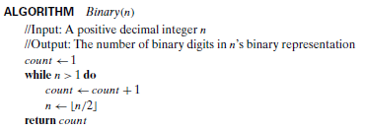
Mathematical Analysis of Nonrecursive Algorithms - Examples
Number of times the ‘while’ loop will be executed is:
How?

Slide 46
Mathematical Analysis of Nonrecursive Algorithms
Example:
Consider the following algorithm.
ALGORITHM Mystery(n)
//Input: A nonnegative integer n
S ←0
for i ←1 to n do
S ←S + i ∗ i
return S
a. What does this algorithm compute?
b. What is its basic operation?
c. How many times is the basic operation executed?
d. What is the efficiency class of this algorithm?
e. Suggest an improvement, or a better algorithm altogether, and indicate its efficiency class.

Slide 47
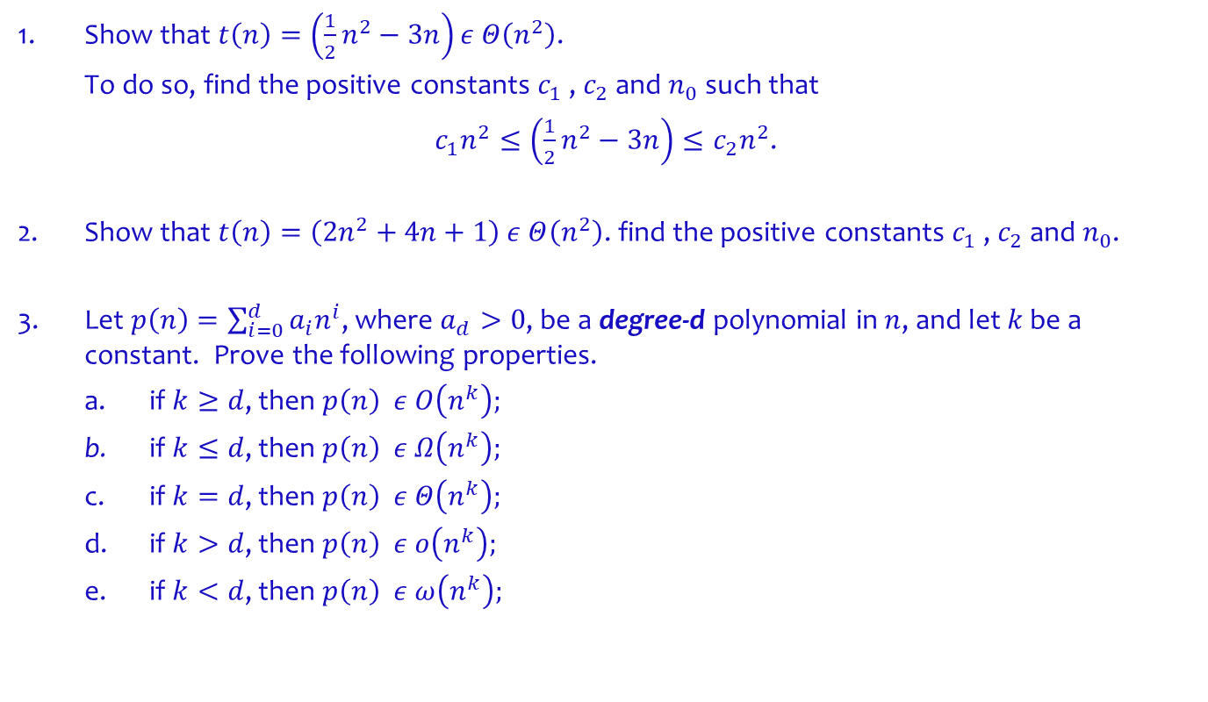
Examples
1. Show that $t\left(n\right)=\left(\frac{1}{2}n^{2}−3n\right)ε Θ\left(n^{2}\right)$.
To do so, find the positive constants $c_{1}$ , $c_{2}$ and $n_{0}$ such that
$c_{1}n^{2}≤\left(\frac{1}{2}n^{2}−3n\right)≤c_{2}n^{2}$.
2. Show that $t\left(n\right)=\left(2n^{2}+4n+1\right) ε Θ\left(n^{2}\right)$. find the positive constants $c_{1}$ , $c_{2}$ and $n_{0}$.
3. Let $p\left(n\right)=\sum_{i=0}^{d}{a_{i}n^{i}}$, where $a_{d}>0$, be a degree-d polynomial in $n$, and let $k$ be a constant. Prove the following properties.
a. if $k≥d$, then $p\left(n\right) ε Ο\left(n^{k}\right);$
b. if $k≤d$, then $p\left(n\right) ε Ω\left(n^{k}\right);$
c. if $k=d$, then $p\left(n\right) ε Θ\left(n^{k}\right);$
d. if $k>d$, then $p\left(n\right) ε ο\left(n^{k}\right);$
e. if $k<d$, then $p\left(n\right) ε ω\left(n^{k}\right);$

Slide 48



Examples

Slide 49

Examples
Is $2^{n}$ a good approximation of complexity for evaluation of $n!?$
$$\lim_{\text{n}\text{→∞ }}{\frac{\text{n}\text{!} }{2^{n}}}$$

Slide 50
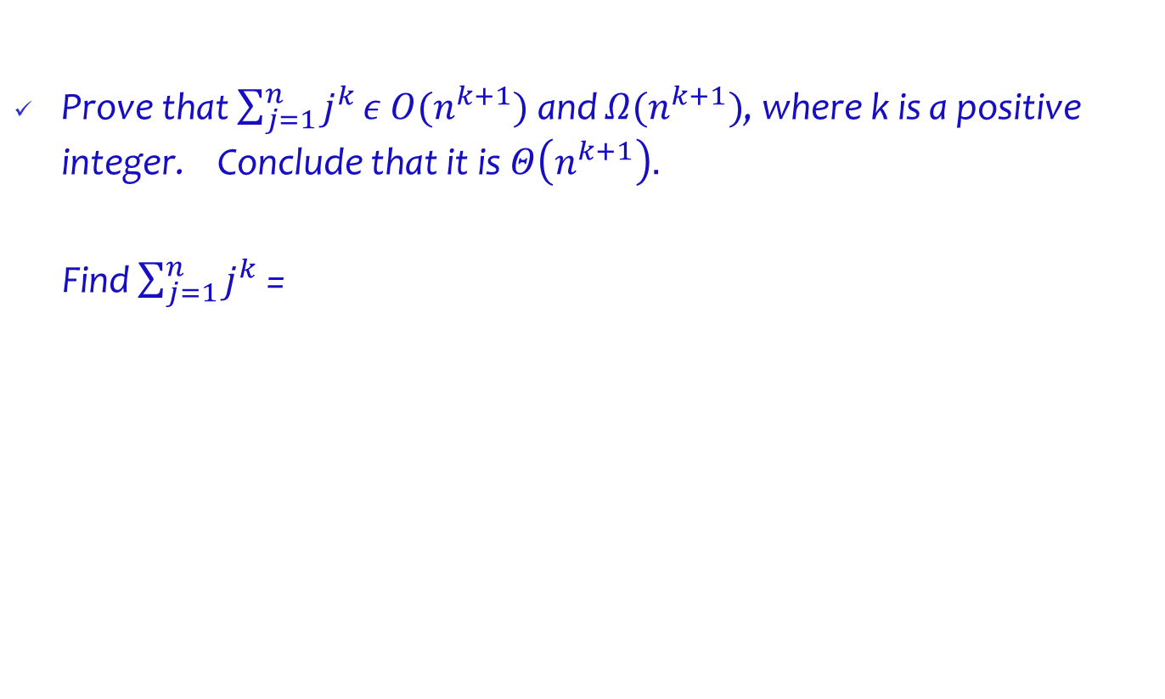
Examples
Prove that $\sum_{j=1}^{n}{j^{k}}ε$ $Ο(n^{k+1})$ and $Ω(n^{k+1})$, where k is a positive integer. Conclude that it is $Θ\left(n^{k+1}\right).$
Find $\sum_{j=1}^{n}{j^{k}}$ =

Slide 51

Examples
Let $f\left(n\right)=\sum_{i=1}^{n}{{\left(\frac{1}{n}\right)}^{i}}$.
Express $f\left(n\right)$ in terms of $Θ$ notation.

Slide 52

Examples
Show that $n^{100}= Ο\left(2^{n}\right)$, but $2^{n}≠{Ο(n}^{100})$.

Slide 53
Recursive Methods and Problem Solving
Terminology:
Typically, a problem instance of size n is divided into two instances of size n/2, both needing to be solved.
More generally, an instance of size n can be divided into b instances of size n/b, with a of them needing to be solved.
(Here, a and b are constants; a ≥ 1 and b > 1.)
Assume that size n is a power of b to simplify our analysis, we get the following recurrence for the running time T (n):
T (n) = aT (n/b) + f (n) where where f (n) is a function that accounts for the time spent on dividing an instance of size n into instances of size n/b and combining their solutions.
The order of growth of its solution T (n) depends on the values of the constants a and b and the order of growth of the function f (n).

Slide 54
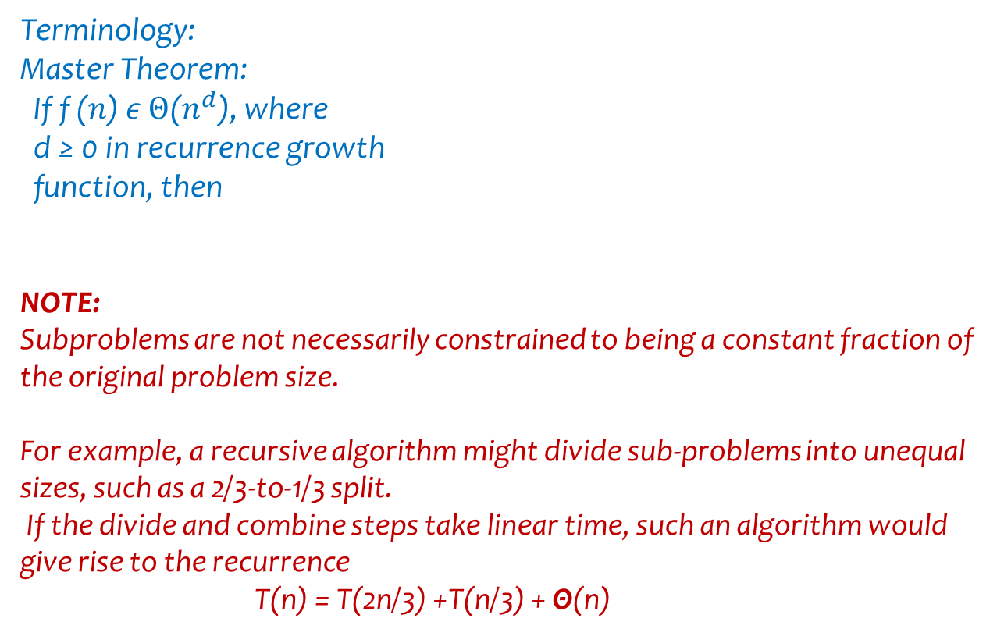
Recursive Methods and Problem Solving
Terminology:
Master Theorem:
If f ($n$) $ε Θ$($n^{d}$), where
d ≥ 0 in recurrence growth
function, then
NOTE:
Subproblems are not necessarily constrained to being a constant fraction of the original problem size.
For example, a recursive algorithm might divide sub-problems into unequal sizes, such as a 2/3-to-1/3 split.
If the divide and combine steps take linear time, such an algorithm would give rise to the recurrence
T(n) = T(2n/3) +T(n/3) + Θ(n)

Slide 55
Recursive Methods and Problem Solving
Each call solves an identical problem
The code is the same!
Successive calls solve smaller/simpler instances
Every recursive algorithm has at least one base case
A known/easy to solve case
Often, when we reach 1 or 0

Slide 56
Recursive Methods and Problem Solving
Questions to ask yourself
How can we reduce the problem to smaller version of the same problem?
How does each call make the problem smaller?
What is the base case?
Will you always reach the base case?

Slide 57
Recursive Methods and Problem Solving
Recursive Definitions
Directly recursive: method that calls itself
Indirectly recursive: method that calls another method and eventually results in the original method call
Tail recursive method: recursive method in which the last statement executed is the recursive call
Infinite recursion: case where every recursive call results in another recursive call

Slide 58
Recursive Methods and Problem Solving
Tracing a Recursive Method
As always, go line by line
Recursive methods may have many copies
Every method call creates a new copy and transfers flow of control to the new copy
Each copy has its own:
code
parameters
local variables

Slide 59
Recursive Methods and Problem Solving
Tracing a Recursive Method
After completing a recursive call:
Control goes back to the calling environment
Recursive call must execute completely before control goes back to previous call
Execution in previous call begins from point immediately following recursive call

Slide 60
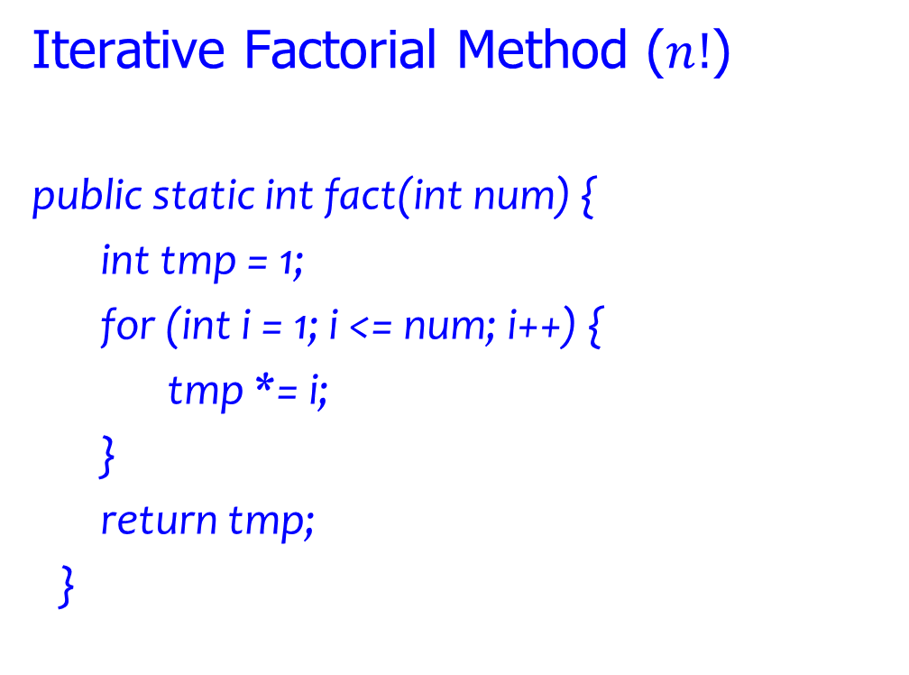
Recursive Methods and Problem Solving
Iterative Factorial Method ($n!$)
public static int fact(int num) {
int tmp = 1;
for (int i = 1; i <= num; i++) {
tmp *= i;
}
return tmp;
}

Slide 61
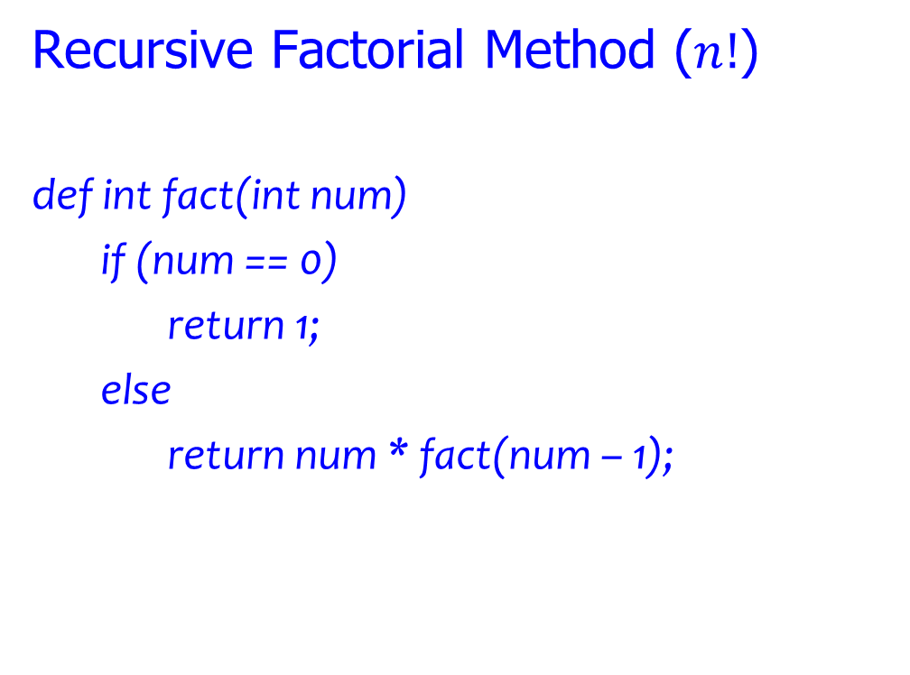
Recursive Methods and Problem Solving
Recursive Factorial Method ($n!$)
def int fact(int num)
if (num == 0)
return 1;
else
return num * fact(num – 1);

Slide 62
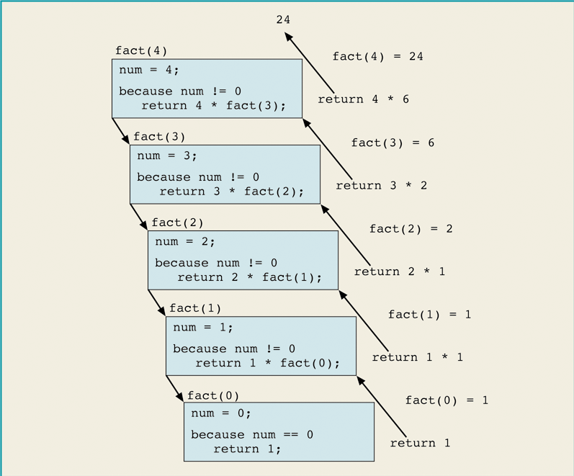

Recursive Factorial Trace
Execution of the expression 4$!$

Slide 63

Recursive Methods and Problem Solving
Recurrence Relation for the Factorial problem ($n!$):
F(n) = F(n-1) $∙$ n Factorial problem
T(n) = T(n-1) + 1 Time Complexity

Slide 64

Recursive Methods and Problem Solving
Given T(n) = T(n-1) + 1 Time Complexity expression
& the base case T(o) = 0
Show that T(n) = $Θ\left(n\right)$

Slide 65

Recursive Methods and Problem Solving
Given a Recurrence Time Complexity Relation :
T(n) = T(n-1) + n, where n$≥0$ & T(0) = 0
Show that T(n) = $Θ(n^{2})$

Slide 66

Recursive Methods and Problem Solving
In general for a problem of input size n determine an asymptotically tight solution to the recurrence
T(n) = T(n-a) + T(a) + cn, where a $≥$1 and c > 0 are constants.
Assume n = ka, where k >0 is a constant.
Then using backward substitution,
T(n) = T(n-a) + T(a) + cn
T(n-a) = T(n-2a) + T(a) + c(n-a)
T(n-2a) = T(n-3a) +T(a) + c(n-2a)
…
T(2a) = T(a) + T(a) + c(2a)
This solution is not complete. In process.

Slide 67
Recursion or Iteration?
Moral: There is usually more than one way to solve a problem!
Iteration (loops to repeat code)
Recursion (nested function calls to repeat code)
Tradeoffs between two options:
Sometimes recursive solution is easier
Recursive solution is often slower
Recursive is suited for complex problems where it would be difficult to implement iteration method.

Slide 68
Recursion – Divide and Conquer Example
a. Write pseudocode for a divide-and-conquer algorithm for the exponentiation problem of computing an where n is a positive integer.
b. Set up and solve a recurrence relation for the number of multiplications made by this algorithm.
c. How does this algorithm compare with the brute-force algorithm for this problem?
Hint: How would you compute a⁸ by solving two exponentiation problems of size 4? How about a⁹?

Slide 69
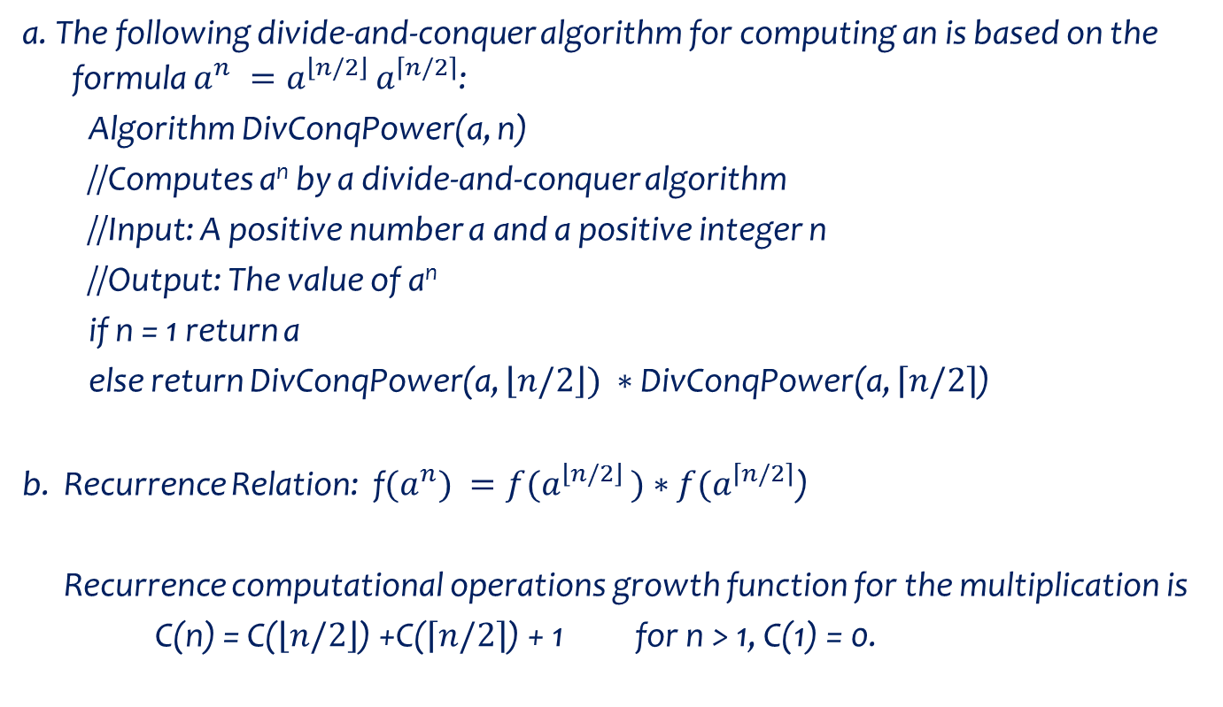
Recursion – Divide and Conquer Example
a. The following divide-and-conquer algorithm for computing an is based on the formula $a^{n} =a^{\left\lfloor n/2\right\rfloor }a^{\left\lceil n/2\right\rceil }$:
Algorithm DivConqPower(a, n)
//Computes a^{n} by a divide-and-conquer algorithm
//Input: A positive number a and a positive integer n
//Output: The value of a^{n}
if n = 1 return a
else return DivConqPower(a, $\left\lfloor n/2\right\rfloor ) ∗$ DivConqPower(a, $\left\lceil n/2\right\rceil$)
b. Recurrence Relation: f${(a}^{n}) ={f(a}^{\left\lfloor n/2\right\rfloor })∗f(a^{\left\lceil n/2\right\rceil }$)
Recurrence computational operations growth function for the multiplication is
C(n) = C($\left\lfloor n/2\right\rfloor$) +C($\left\lceil n/2\right\rceil$) + 1 for n > 1, C(1) = 0.
Label C is used here instead of T

Slide 70
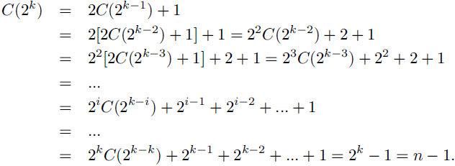
Recursion – Divide and Conquer Example
b. Solving it by backward substitutions for n = 2^{k} yields:
c. The algorithm makes the same number of multiplications as the brute-force method.
But it has to be considered inferior to the brute-force because of the recursion overhead.

Slide 71
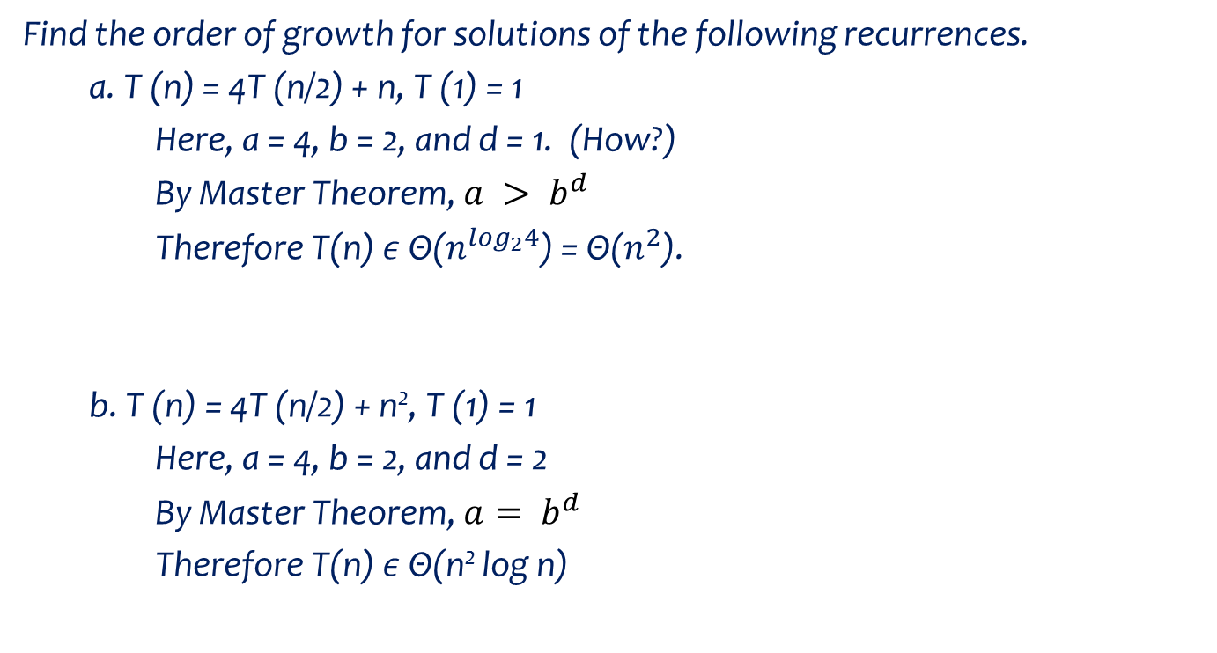
Recursion – Divide and Conquer Example
Find the order of growth for solutions of the following recurrences.
a. T (n) = 4T (n/2) + n, T (1) = 1
Here, a = 4, b = 2, and d = 1. (How?)
By Master Theorem, $a > b^{d }$
Therefore T(n) $ε$ Θ($n^{\log_{2}4}$) = Θ($n^{2}$).
b. T (n) = 4T (n/2) + n², T (1) = 1
Here, a = 4, b = 2, and d = 2
By Master Theorem, $a= b^{d }$
Therefore T(n) $ε$ Θ(n² log n)

Slide 72
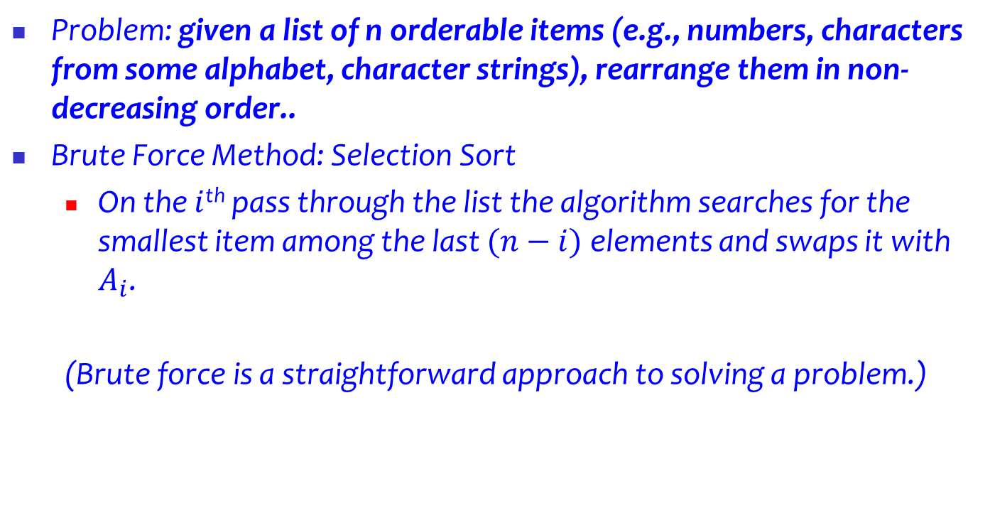
Example - Recursive Methods and Problem Solving
Problem: given a list of n orderable items (e.g., numbers, characters from some alphabet, character strings), rearrange them in non-decreasing order..
Brute Force Method: Selection Sort
On the $i$^{th} pass through the list the algorithm searches for the smallest item among the last $(n−i)$elements and swaps it with $A_{i}$.
(Brute force is a straightforward approach to solving a problem.)

Slide 73

Example - Recursive Methods and Problem Solving
Example – Selection Sort:
Pseudocode of algorithm:
As an example, the action of the algorithm on the
list 89, 45, 68, 90, 29, 34, 17 is illustrated in the Figure.
Basic operation?
How many in each inner loop?

Slide 74
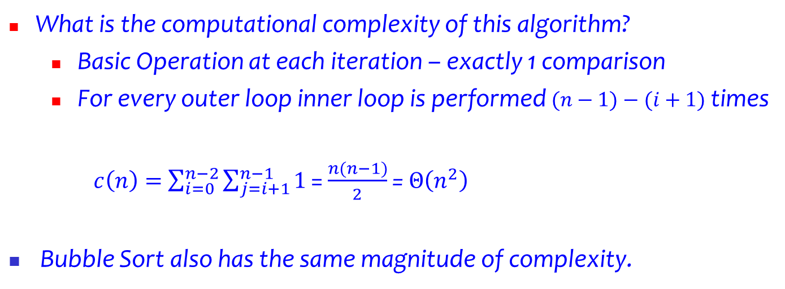
Example - Recursive Methods and Problem Solving
What is the computational complexity of this algorithm?
Basic Operation at each iteration – exactly 1 comparison
For every outer loop inner loop is performed $(n−1)−(i+1)$ times
$c\left(n\right)=$ $\sum_{i=0}^{n−2}{\sum_{j=i+1}^{n−1}{1}}$ = $\frac{n(n−1)}{2}$ = $Θ\left(n^{2}\right)$
Bubble Sort also has the same magnitude of complexity.

Slide 75
Example - Recursive Methods and Problem Solving
Can we determine a more efficient algorithm for the sorting problem?
YES!

Slide 76
Example - Recursive Methods and Problem Solving
Method: Merge Sort
Divide the n-element sequence into two subsequences of n/2 elements each. (Divide)
Sort the two subsequences recursively using Merge Sort. (Conquer)
Merge the two sorted subsequences to produce the sorted answer. (Combine)

Slide 77

Example - Recursive Methods and Problem Solving
? What is the computational complexity of the MergeSort?
T(n) = 2T(n/2)+ T_{merge}(n) for n$>1$, T(1)=1
T_{merge}(n) = (n-1) = $Θ$(n) Why/How?
Consider the following two 4-element arrays
1 3 5 7 2 4 6 8
Basic operation in merging – comparison (of?)

Slide 78

Example – MergeSort
Assume n = 2^{k}
Then,
(1) T(n) = 2T(n/2) + n
(2) T(n)/n = T(n/2)/(n/2) + 1 (we get (2) dividing (1) by n)
(3) T(n/2)/(n/2) = T(n/4)/(n/4) + 1
(4) T(n/4)/(n/4) = T(n/8)/(n/8) + 1
(5) T(n/8)/(n/8) = T(n/16)/(n/16) + 1
…
(k) T(2)/(2) = T(1)/(1) + 1
Adding equations (1) through (k) we get,
T(n)/n = 1 + k (verify for yourself!)
Substituting k = log₂n we get T(n) = n + n log₂n = $Θ$(n log₂n)

Slide 79

Example – MergeSort
Assume n = 2^{k}
Then,
(1) T(n) = 2T(n/2) + n
From (1) a=2, b=2, d=1 (verify for yourself!)
From Master Theorem, a = b^{d}.
Therefore T(n) = $Θ$(n log₂n)

Slide 80
Example – MergeSort

Slide 81
Example – MergeSort

Slide 82
Example – MergeSort (Food for thought)
(1) Is mergesort a stable sorting algorithm?
(2) Set up a recurrence relation for the number of key comparisons made by mergesort on best-case inputs and solve it for n = 2k.

Slide 83

Example – Computational Complexity of Karatsuba Method
c₂ = a1 ∗ b1 is the product of their first halves,
c₀ = a0 ∗ b0 is the product of their second halves,
c₁ = (a1 + a0) ∗ (b1 + b0) − (c₂ + c₀) is the product of the sum of the a’s halves and the sum of the b’s halves minus the sum of c2 and c0.
c = c₂ 10^{n} + c₁ 10^{n/2} + c₀
Assume n = 2^{k}
Operations: Division of number strings – divide each number string into two strings
Multiplications – 3 per recursive call
Additions/Subtractions – 5 additions and 1 subtraction
T(n) = 3T(n/2) + $Θ$(n) for n>1, T(1) = 1

Slide 84

Example – Computational Complexity of Karatsuba Method
T(n) = 3T(n/2) + $Θ$(n) for n>1, T(1) = 1
What are the values of a, b and d?
a = b= d=
Using Master Theorem what is the expression for the computational complexity?

Slide 85

Example – Computational Complexity of Karatsuba Method
M(n) = 3M(n/2) for n>1, M(1) = 1
M(2k) =3 M(2^{k-1}) = 3(3 M(2^{k-2})) = 3² M(2^{k-2}) Backward Substitution
= 3^{i} M(2^{k-i}) = … = 3^{k} M(2^{k-k}) = 3^{k}
= $3^{\log_{2}n}$ since k = $\log_{2}n$
= $n^{\log_{2}3}$ $≈ n^{1.585}$
Number of digits of additions:
A(n) $≤$ 3 A(n/2) + cn
by the Master Theorem A(n) $≈$ $Θ$(${\text{n}}^{\log_{2}3})$
Therefore Karatsuba method complexity is $Θ$(${\text{n}}^{\log_{2}3})$ $≈Θ$(${\text{n}}^{1.585})$.
What is the Brute Force method complexity for multiplying two large n-digit numbers?
WHY?

Slide 86

Examples
a. Prove the equality $a^{\log_{b}{c}}$= $c^{\log_{b}{a}}$.
b. Why is $n^{\log_{2}{3}}$better than $3^{\log_{2}{n}}$as a closed-form formula for T(n)?

Slide 87

Matrix Multiplication – Strassen’s Method
Product of two 2x2 matrices:
$\left[\begin{matrix}c_{00} & c_{01} \\ c_{10} & c_{11}\end{matrix}\right]=\left[\begin{matrix}a_{00} & a_{01} \\ a_{10} & a_{11}\end{matrix}\right]∗$ $\left[\begin{matrix}b_{00} & b_{01} \\ b_{10} & b_{11}\end{matrix}\right]$
By Brute Force method using 8 multiplications and 4 additions we get the answer.
By Strassen’s technique, we get the result using 7 multiplications and 18 additions/subtractions.

Slide 88

Matrix Multiplication – Strassen’s Method
$\left[\begin{matrix}c_{00} & c_{01} \\ c_{10} & c_{11}\end{matrix}\right]=\left[\begin{matrix}a_{00} & a_{01} \\ a_{10} & a_{11}\end{matrix}\right]∗$ $\left[\begin{matrix}b_{00} & b_{01} \\ b_{10} & b_{11}\end{matrix}\right]$
$=$ $\left[\begin{matrix}m_{1}\text{+}m_{4}−m_{5}+m_{7} & m_{3}+m_{5} \\ m_{2}+m_{4} & m_{1}\text{+}m_{3}−m_{2}+m_{6}\end{matrix}\right]$
Where,

Slide 89

Matrix Multiplication – Strassen’s Method
Recurrence Relation for Strassen’s method:
T(n) = $\left\{\begin{matrix}m \\ \text{7}\text{T}\text{(}\text{n}\text{/2) + }c∗18{\text{(}n/2\text{)}}^{2}\end{matrix}\right.$ $\begin{matrix}n=1 \\ n≥2\end{matrix}$
Q: Validate above statement!
Q: What is the base case for terminating the recurrence call?

Slide 90

Examples: Matrix Multiplication – Strassen’s Method
1) Apply Strassen’s algorithm to compute: $\left[\begin{matrix}1 & 0 & 2 \\ 4 & 1 & 1 \\ 0 & 1 & 3\end{matrix}\right]∗ \left[\begin{matrix}0 & 1 & 0 \\ 2 & 1 & 0 \\ 2 & 0 & 1\end{matrix}\right]$
exiting the recursion when n = 2, i.e.,
computing the products of 2 ×2 matrices
by the brute-force algorithm.
2)

Slide 91
Examples: Matrix Multiplication – Strassen’s Method
3) V. Pan discovered a way of multiplying 68 * 68 matrices using 132,464 multiplications, a way of multiplying 70 * 70 matrices using 143,640 multiplications, and a way of multiplying 72 * 72 matrices using 155,424 multiplications. Which method yields the best asymptotic running time when used in a divide-and-conquer matrix-multiplication algorithm?
How does it compare to Strassen’s algorithm?

Slide 92

Appendix: Recursion Relations– Exercises
Write a recursive function that prints the numbers 1…n in descending order.
F(1…n) = F(1…n-1)$∘$ n where $∘$ implies the operation of printing n
revprt (n)
If n<>0 revprt(n-1)
Write a recursive function to perform exponentiation; return x^{m}, assuming m >= 0
$f\left(x^{m}\right)=$ $f\left(x^{m−1}\right)$ $∗$ $x$
$f(x,m)= x∗f(x,m−1)$

Slide 93
Appendix: Writing a recursive function
Write a recursive method printBinary that accepts an integer and prints that number's representation in binary (base 2).
Example: printBinary(7) prints 111
Example: printBinary(12) prints 1100
Example: printBinary(42) prints 101010
Write the method recursively and without using any loops.
place | 10 | 1 |  | 32 | 16 | 8 | 4 | 2 | 1
value | 4 | 2 |  | 1 | 0 | 1 | 0 | 1 | 0

Slide 94
Appendix: Writing a recursive function
// Prints the given integer's binary representation.
// Precondition: n >= 0
public static void printBinary(int n) {
if (n < 2) {
// base case; same as base 10
System.out.println(n);
} else {
// recursive case; break number apart
printBinary(n / 2);
printBinary(n % 2);
}
}

Slide 95

Appendix: Analyzing a recursive function
What is recurrence function in this case?
F(n) = F(n/2) $∘$ (n mod 2)

Slide 96
Appendix: Analyzing a recursive function
Basic operation?
Estimation of operation count!
Can we eliminate the precondition and deal with negatives?

Slide 97
Appendix: Reversal pseudocode (Food for thought)
Reversing the lines of a file:
Read a line L from the file.
Print the rest of the lines in reverse order.
Print the line L.
If only we had a way to reverse the rest of the lines of the file....

Slide 98
Appendix: Reversal solution (Food for thought)
public static void reverseLines(Scanner input) {
if (input.hasNextLine()) {
// recursive case
String line = input.nextLine();
reverseLines(input);
System.out.println(line);
}
}
What is the base case?

Slide 99
Appendix: Recursion – Food for Thought Exercises (HW)
ALGORITHM S(n)
//Input: A positive integer n
//Output: The sum of the first n cubes
if n = 1 return 1
else return S(n − 1) + n ∗ n ∗ n
a. Set up and solve a recurrence relation for the number of times the algorithm’s basic operation is executed.
b. How does this algorithm compare with the straight-forward nonrecursive algorithm for computing this sum?

Slide 100
Recursive Methods - Challenges
Forgetting a base case
Infinite recursion resulting in StackOverflowError
Working away from the base case
The recursive case must make progress towards the base case
Infinite recursion resulting in StackOverflowError
Running out of memory
Even when making progress to the base case, some inputs may require too many recursive calls: StackOverflowError
Recomputing the same subproblem over and over again
Refining the algorithm could save significant time

Slide 101
Recursion Methods and Problem Solving (HW)
Q: Let A[0..n − 1] be an array of n real numbers. A pair (A[i], A[j ]) is said to be an inversion if these numbers are out of order, i.e., i < j but A[i]>A[j ]. Design an O(n log n) algorithm for counting the number of inversions.

Slide 102

Recursion Methods – Strassen’s Algorithm (HW)
Q: What is the largest k such that if you can multiply 3*3 matrices using k multiplications (not assuming commutativity of multiplication), then you can multiply n * n matrices in time o(n^{lg 7})?
What would the running time of this algorithm be?
Q: When n$≠2^{k}$ how do we apply Strassen’s algorithm?
Implement the Strassen’s algorithm.
Test cases: 1) $\left[\begin{matrix}1 & 0 & 2 \\ 4 & 1 & 1 \\ 0 & 1 & 3\end{matrix}\right]∗ \left[\begin{matrix}0 & 1 & 0 \\ 2 & 1 & 0 \\ 2 & 0 & 1\end{matrix}\right]$ 2) $\left[\begin{matrix}1 & 0 & \begin{matrix}2 & 1\end{matrix} \\ 4 & 1 & \begin{matrix}1 & 0\end{matrix} \\ \begin{matrix}0 \\ 5\end{matrix} & \begin{matrix}1 \\ 0\end{matrix} & \begin{matrix}\begin{matrix}3 \\ 2\end{matrix} & \begin{matrix}0 \\ 1\end{matrix}\end{matrix}\end{matrix}\right]∗ \left[\begin{matrix}0 & 1 & \begin{matrix}0 & 1\end{matrix} \\ 2 & 1 & \begin{matrix}0 & 4\end{matrix} \\ \begin{matrix}2 \\ 1\end{matrix} & \begin{matrix}0 \\ 3\end{matrix} & \begin{matrix}\begin{matrix}1 & 1\end{matrix} \\ \begin{matrix}5 & 0\end{matrix}\end{matrix}\end{matrix}\right]$

Slide 103
Questions ?!

